Slide 1


Research and Implementation of Face Detection Algorithm
Yingda Dong YD995
Xiaoyu Zhang XZ1622
Yezhong Xu YX1209
Yu Lu YL4444

Slide 2
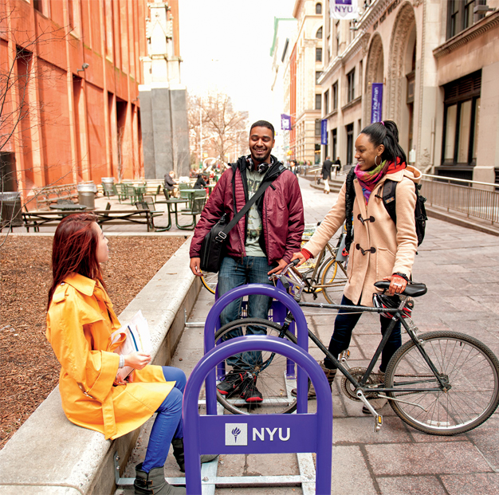
Face Detection Introduction
What is face detection?
Face detection refers to the process of determining the position and size of all faces in the detected image

Slide 3
Common methods
·Color-based approach
·Method based on template matching
·Method based on statistical models
·Method based on artificial neural network

Slide 4
Test evaluation index
Detection rate: The ratio of the number of faces detected correctly to the number of faces actually contained in the image
False rate: the ratio of the number of false faces detected to the number of images
Detection speed: the time to complete face detection
Robustness: The system is adaptable under a variety of conditions

Slide 5
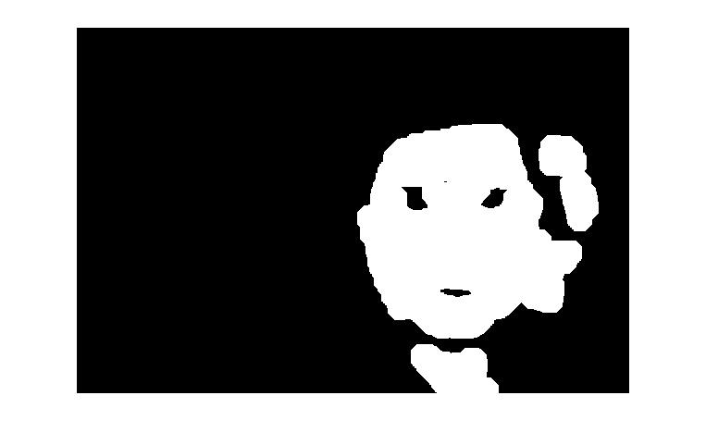

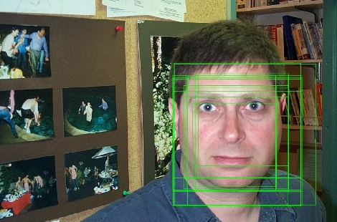
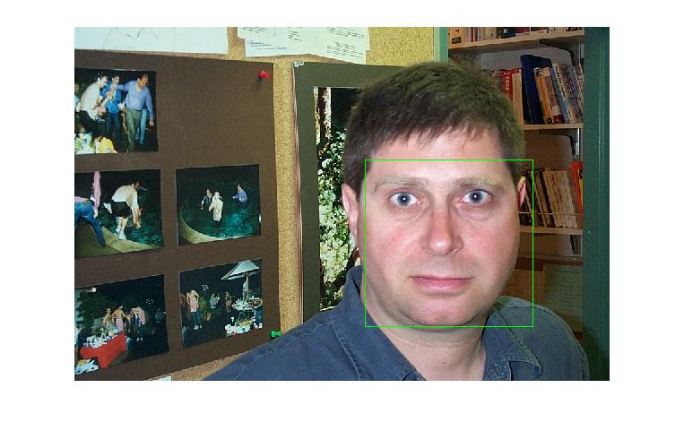
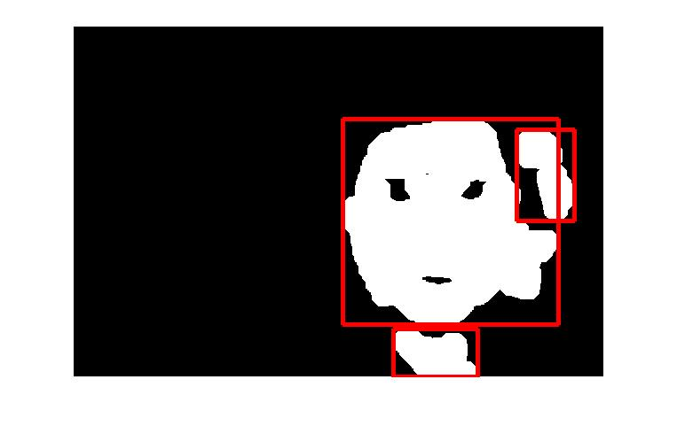
Pretreatment
scanning
judgment
merge
frame
image
(Box color area)

Slide 6
Image preprocessing
YCrCb color space:
Y: Brightness, that is, grayscale value
Cr, Cb: Describes the image color and saturation
Skin color range (threshold and segmentation)
Binary image

Slide 7
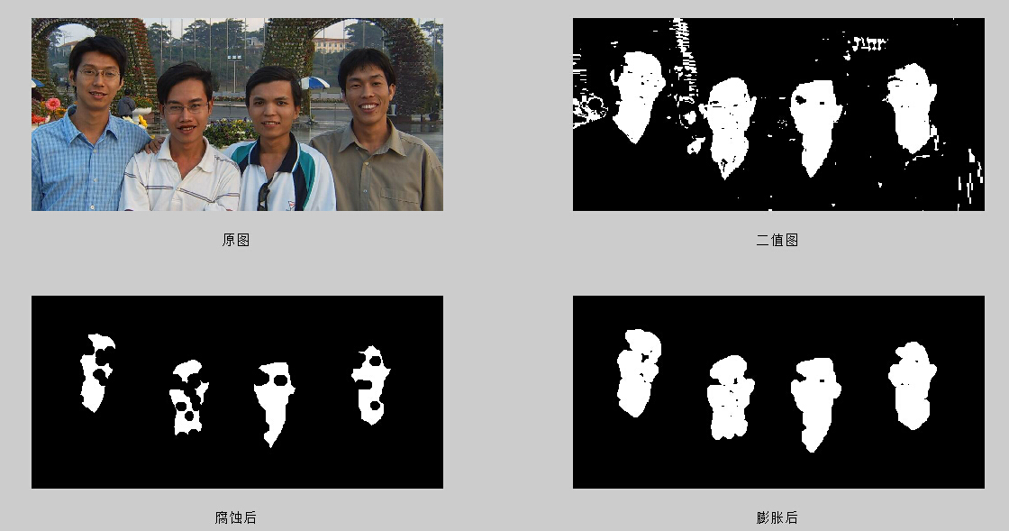
Image expansion and corrosion
The binary image is denoised
Corrosion of the image:
Eliminate physical boundary points
To reduce the target
Eliminate noise points
Expansion of the image:
Fill the hole in the goal
Increase the goal
Background points in the merged object

Slide 8
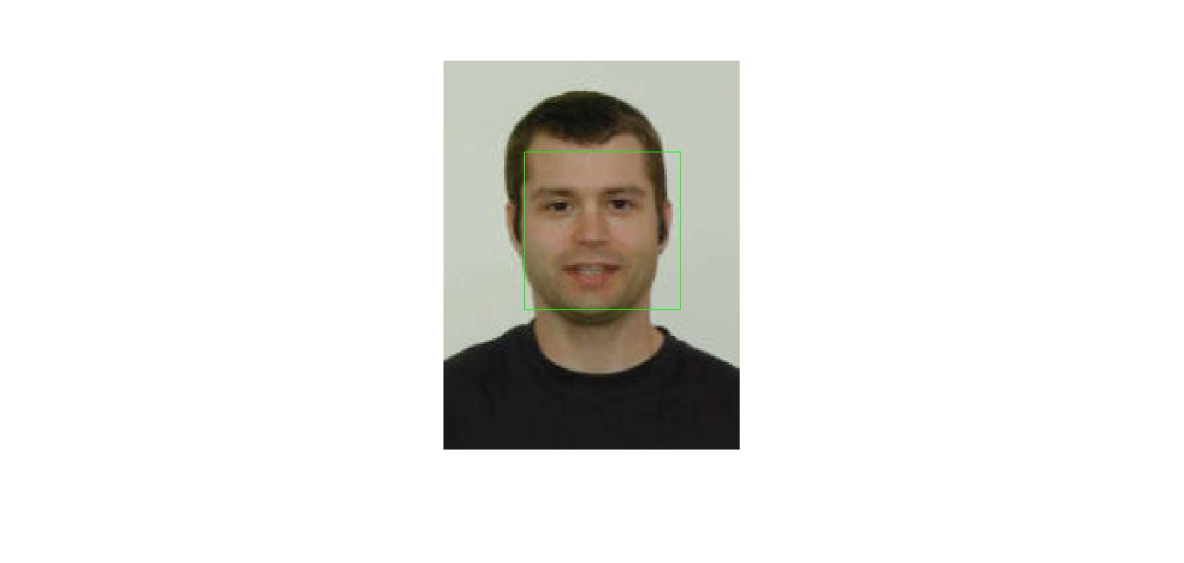
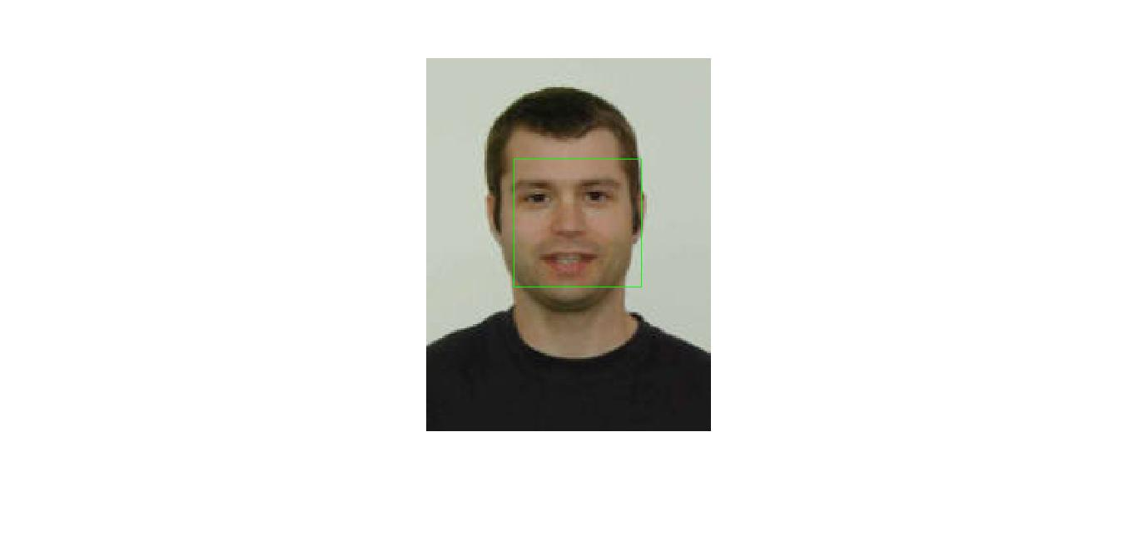
Merge window
Merger conditions: coincidence to a certain extent
Two methods of consolidation:
is to take the maximum of the coincidence window
(2) calculate the average coincidence window

Slide 9
Adaboost - based Face Detection Algorithm
Haar-like features
Adaboost algorithm
Stacked structure

Slide 10
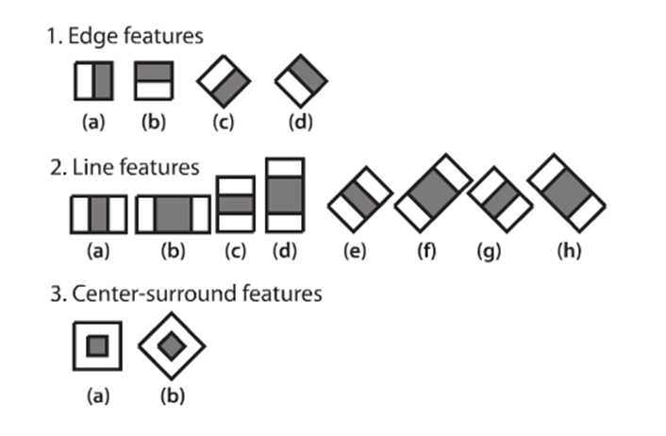
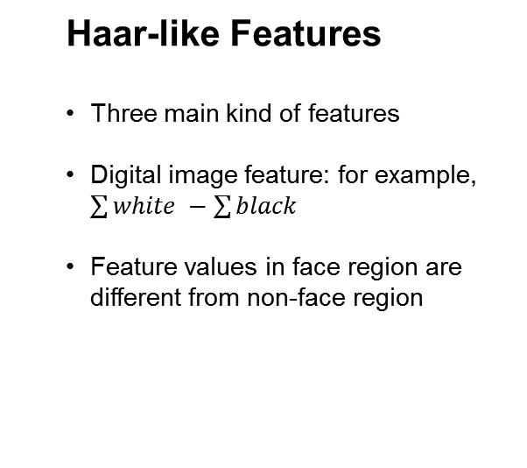
Face Detection by Haar Cascade
Haar-like Features
Three main kind of features
Digital image feature: for example, $\sum{white} −\sum{black}$
Feature values in face region are different from non-face region

Slide 11
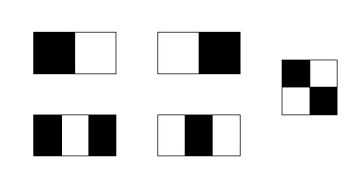
Haar-like features
Feature template
size
position
Eigenvalues ​​= pixels and black areas - pixels and white areas

Slide 12
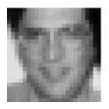
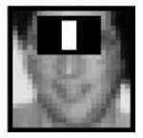

Haar-like features
21x21 window
Five kinds of feature templates
Over 100,000 features

Slide 13
Points graph
For each point in the image ( x, y ) we calculate
Where i ( x, y ) is the pixel value at point ( x, y ) and ii ( x, y ) is the integral image value at point ( x, y ).

Slide 14
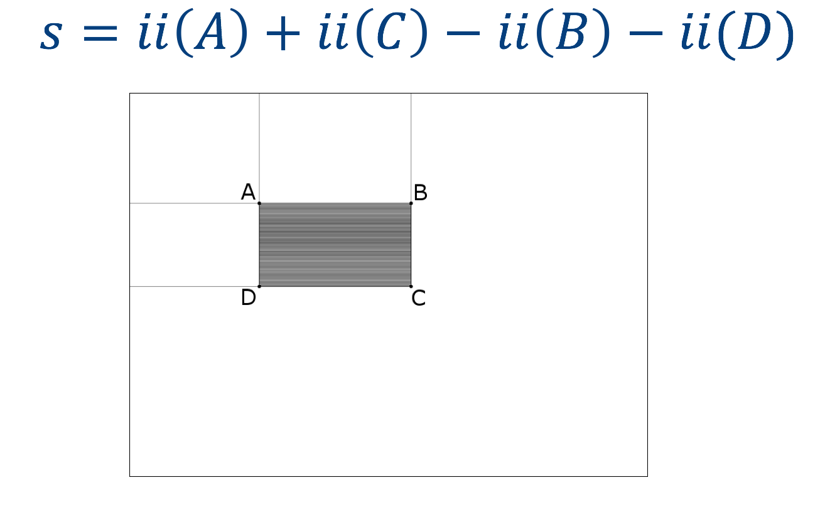
Points graph
If we need to calculate the pixels in the black region and s , we can use the integral graph to calculate

Slide 15
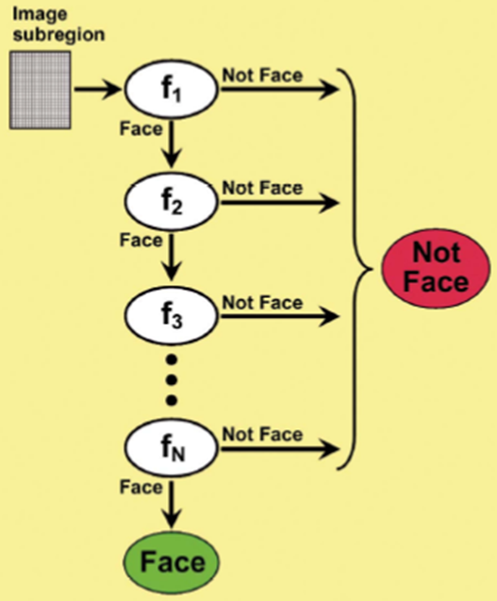
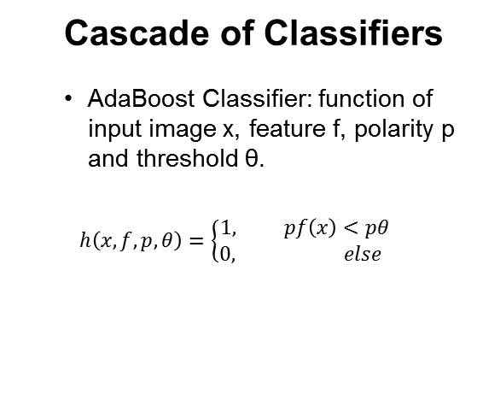
Face Detection by Haar Cascade
Cascade of Classifiers
AdaBoost Classifier: function of input image x, feature f, polarity p and threshold θ.
$$h\left(x,f,p,θ\right)=\left\{\begin{aligned}1, pf\left(x\right)<pθ \\ 0, else \end{aligned}\right.$$

Slide 16
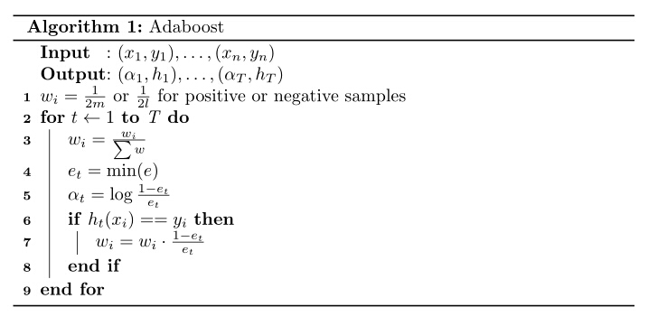
Adaboost Algorithm

Slide 17

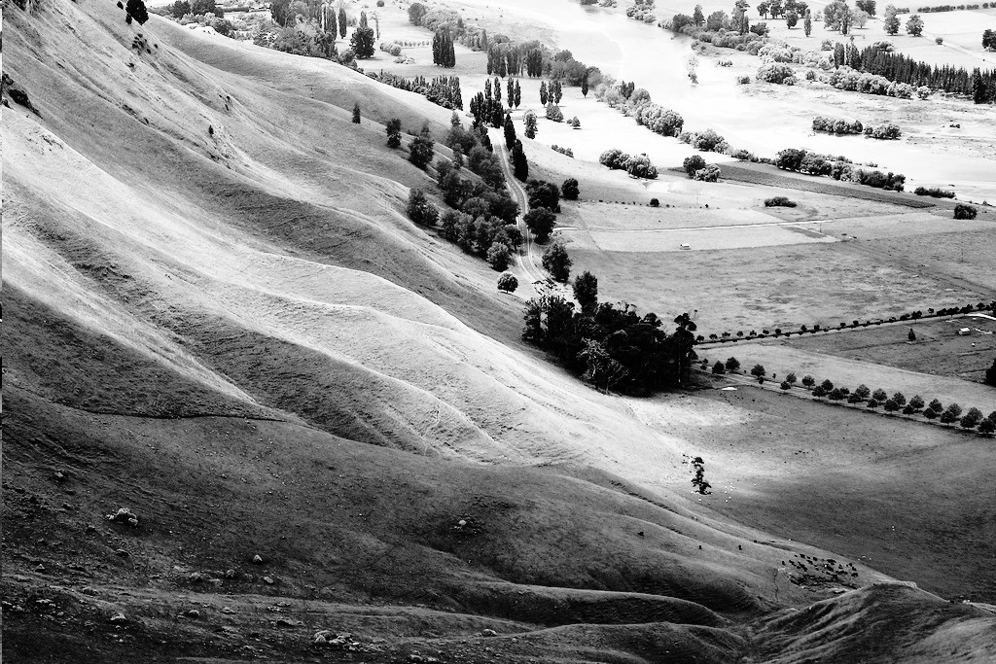
Face Detection by Haar Cascade
Histogram Equalization
Contrast adjustment using the image's histogram
Improve contrast to make feature extraction easier
(source: https://en.wikipedia.org/wiki/Histogram_equalization)

Slide 18
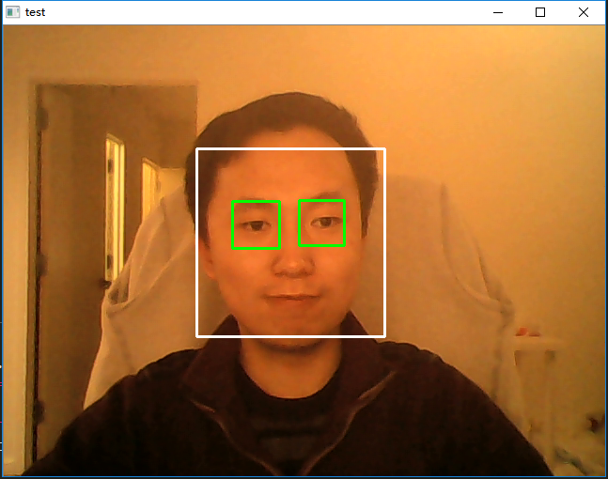
Face Detection by Haar Cascade
Test of Face Detection
Used haarcascade_frontalface_alt.xml and harrcascade_eye.xml as classifiers (provided in cv2 data)

Slide 19
Face Recognition

Slide 20
Face Recognition
Concept of Eigenface
A set of eigenfaces can be generated by performing a mathematical process called principal component analysis (PCA) on a large set of images depicting different human faces.
Procedure
Calculate average image Ψ and get mean normalized image matrix Φ, the average matrix represents a “common face” of certain user.
Calculate covariance matrix, then calculate eigenvalues and eigenvectors for every face.
Use eigenvector of face in database to find out the minimum error between input face and faces in database. If error is greater than a threshold, set the input face to be “unknown”.

Slide 21
Face detection algorithm based on convolutional neural network
Convolution kernel
Automatic extraction of features
Adaptability

Slide 22
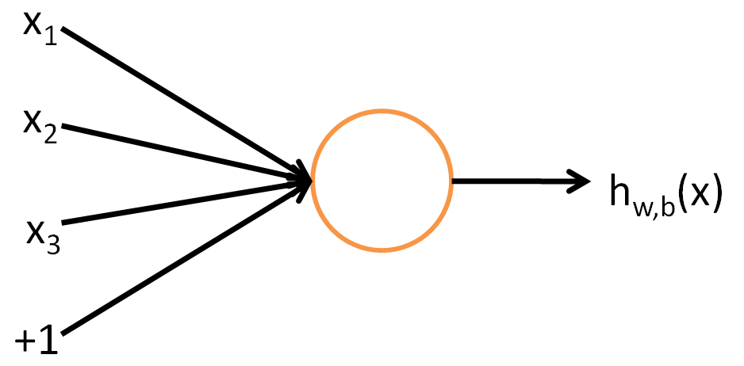
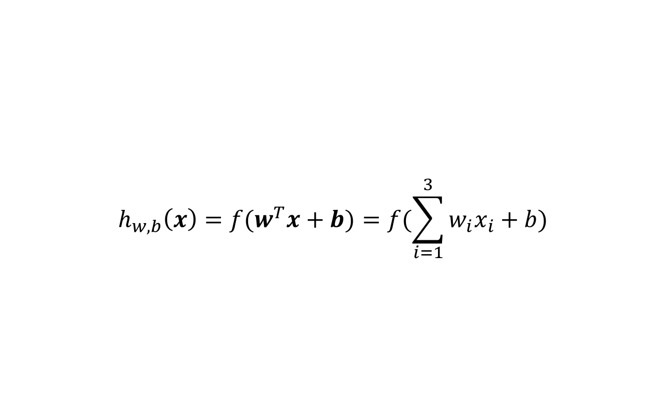
Artificial neural networks
Neurons
$$h_{w,b}\left(x\right)={f(w}^{T}x+b)=f(\sum_{i=1}^{3}{w_{i}x_{i}+b})$$

Slide 23
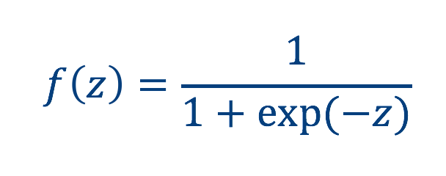
Excitation function (sigmoid function)
Role: increase non-linear changes

Slide 24
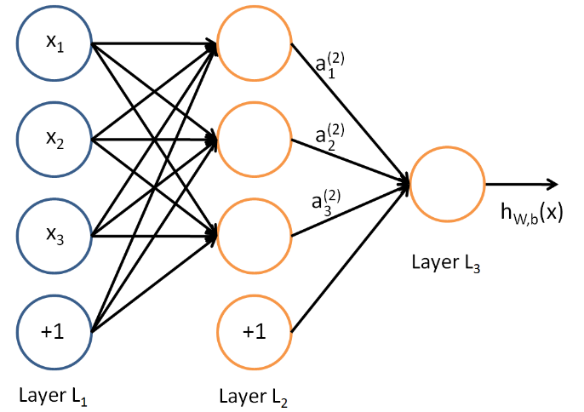
Multilayer neural network

Slide 25
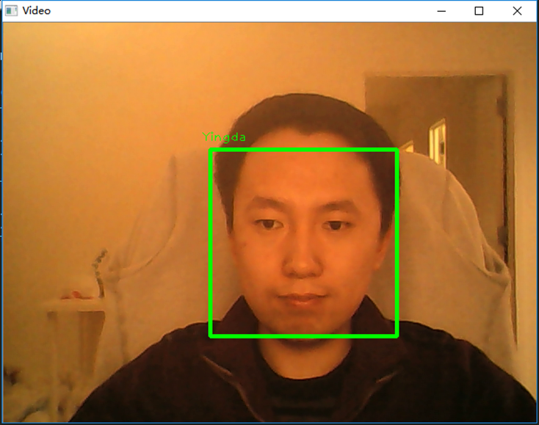
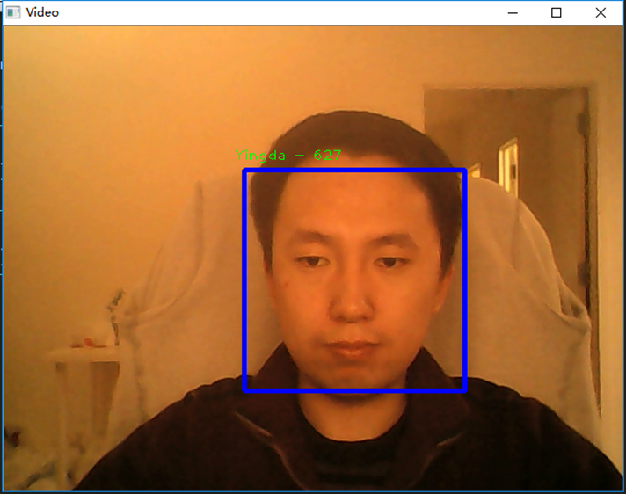
Face Recognition
Test of Face Recognition
Training process (acquire image from camera and use them as database)
Recognition process, the error is shown at the top of rectangle

Slide 26
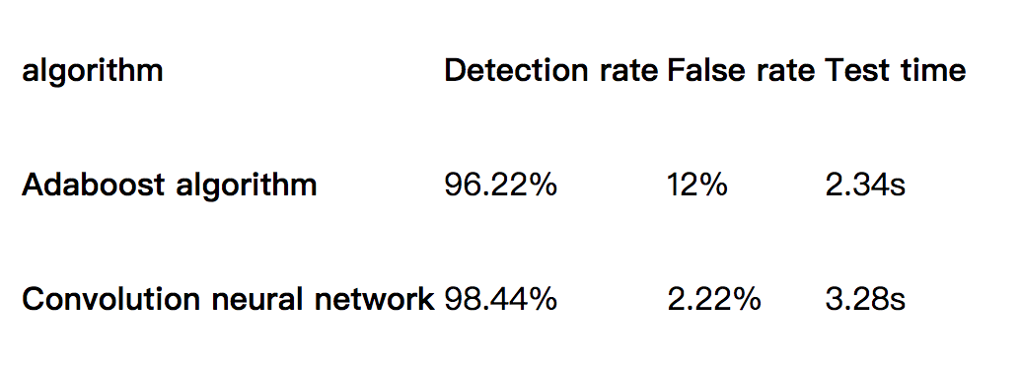
Result
We use Adaboost and Convolutional Neural Network respectively. The database used for the experiment is the Caltech face library, which contains 450 single-face samples.

